Slide 1




Paul Chapman & Pas Apicella

Slide 2
Part 1: Spring Update
Paul Chapman Senior Consultant, Pivotal
pchapman@gopivotal.com
GitHub: paulc4 – these slides and demos

Slide 3

Spring Update
What is Pivotal?
Spring V4
Spring IO
Spring’s sub-projects
Spring Data
Spring Boot

Slide 4
Spring Update
What is Pivotal?
Spring V4
Spring IO
Spring’s sub-projects
Spring Data
Spring Boot

Slide 5
Pivotal – a Company and a Platform
Company: New home for several VMware/EMC products
Joint venture: VMware, EMC, GE
Platform:
Makes available to any company the type of environment Internet companies like Google, Amazon are using
Open PAAS: run internally and/or on public cloud providers
Virtualized Infrastructure
Flexible, dynamic, on-demand cloud deployment
Sophisticated data-analytics
Spot market trends, real-time system performance
More in Next Section

Slide 6
















Pivotal – The Platform
Pivotal Data Science Labs
Data Fabric
Application Fabric
Ingest & Query: very high-capacity & in-memory
Languages
&
Frameworks
Services
Analytics
Scale-out storage: HDFS/Object
Cloud Fabric
Automation: App Provisioning & Life-cycle
Service Registry
Cloud Abstraction (portability)
...ETC
Notes:
Added “application”

Slide 7
Spring Update
What is Pivotal?
Spring V4
Spring IO
Spring’s sub-projects
Spring Data
Spring Boot

Slide 8
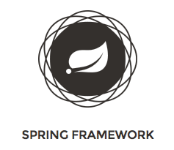
Spring – V4
GA Dec 2013 – but depends on Java 8
Java 8 delayed to H1 2014
Byte-codes currently incompatible with ASM
Highlights
Support for Java 8 (Java 6 minimum)
Core messaging package (from Spring Integration)
@Conditional, @Lazy injection
Web-sockets and AsyncRestTemplate
JMS 2.0, JTA 1.2, JPA 2.1, Servlet 3.0 (2.5 supported) …

Slide 9
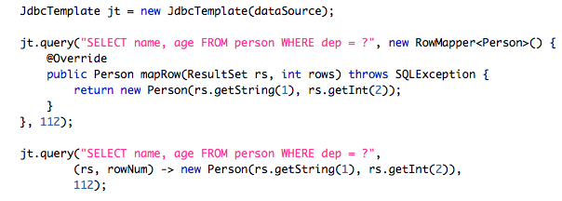
Java 8 – Closures (Lambdas)
Can pass code around like data
Ideal for Spring template callbacks
Old
New
Notes:
A block of code passed around like a variable, for example passed as a method argument, is a Lamda. If it can access data outside itself, it is a closure – just like anonymous inner classes can access final data in the defining method. In general Lamdas which are not closures are not useful and rarely used.

Slide 10
Spring Update
What is Pivotal?
Spring V4
Spring IO
Overview of Spring sub-projects
Spring Data
Spring Boot

Slide 11


Spring IO
Spring is no longer just a framework, it is now a platform
Brings together the Spring family of projects into a cohesive and versioned foundational platform for modern applications
Co-ordinated release trains
New web-site: spring.io
All Spring’s old web-sites redirect here
Incorporates product pages, blog and forums
Plus new HOWTO guides

Slide 12
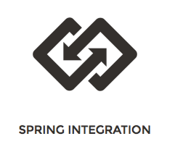

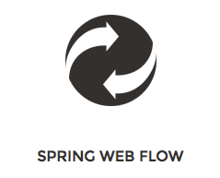
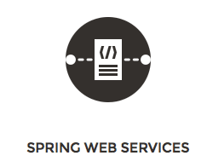

Spring IO Foundation – 1
Projects you probably already know:
SPRING WEB – really just a big, optional sub-module of Framework

Slide 13
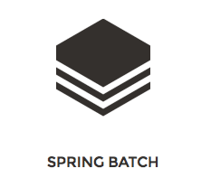
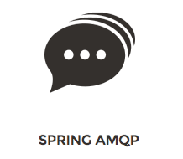
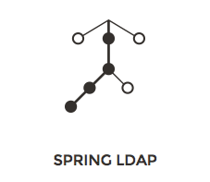
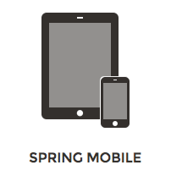
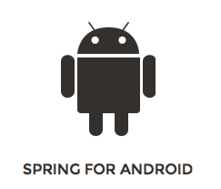
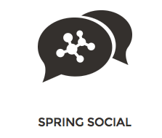
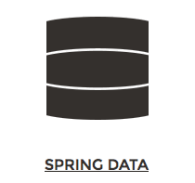
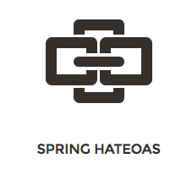
Spring IO Foundation – 2
Projects you may not know so well

Slide 14
Spring Batch
Run jobs to a schedule
Ideal for downsizing from mainframe to mid-range
Equivalent to mainframe job-control language (JCL)
Easier for Java developers than shell scripts
Run multiple processes (steps) in sequence, in parallel
Recover after failed step(s)
Traditional ELT: Export Transform Load
Often used to pull data into specialist databases
Data Warehouse, Hadoop
Which is where Spring XD comes in

Slide 15
Spring AMQP
Advanced Message Queuing Protocol
Common protocol for messaging
Like SMTP for email
Several products: including Pivotal’s open-source Rabbit/MQ
Fast, light, interoperable
How do I get data in/out of my cloud(s)?
Without paying huge licensing fees
Need a common messaging infrastructure
AmqpTemplate: similar to JmsTemplate
<rabbit:listener-container> similar to JMS

Slide 16
Spring LDAP
Lightweight Directory Access Protocol
Both a protocol and an old-style hierarchical database
Project Features
LDAP template (like JdbcTemplate) hides LDAP API
Throws Spring’s unchecked DataAccessExceptions
Classes for dynamically building LDAP filters and Distinguished Names (DNs)
Client-side LDAP transaction management (LDAP has none)
dn: cn=chapman, ou=employees, dc=pivotal, dc=com

Slide 17
Spring Mobile and Social
Spring Mobile
MVC interceptor to enable device detection and site-preferences
Automatically redirect to “mobile” site
Device object available to MVC controllers
Spring Social
Handle user-accounts
Login using Spring Security OAuth
Sub-projects for accessing Facebook, Twitter, LinkedIn data

Slide 18
Spring Android
Provides components of Spring for use in Android apps
REST client for Android
OAuth support for accessing secure APIs
See https://spring.io/guides/gs/consuming-rest-android/

Slide 19
Spring Data
Support for multiple no-SQL databases
JPA, Mongo/DB, Redis, Gemfire, Neo4j, Hadoop, JDBC Extensions
Template classes for database access (like JdbcTemplate)
Annotations for automated persistence (like JPA @Entity)
Spring name-spaces for configuration

Slide 20
Spring Data – Instant Repositories
Just one feature of Spring Data
How?
Annotate domain classes suitably to define keys and enable persistence
Define your repository as an interface
Spring will implement it at run-time
Scans for interfaces extending Repository <T, K>

Slide 21
Spring Data – Mark-up Classes
You do this for JPA anyway
Spring Data defines similar annotations for other storage products
@Entity @Table(...)
public class Customer {
@Id
@GeneratedValue(strategy = GenerationType.AUTO)
private Long id;
private Date firstOrderDate;
private String email;
// Other data-members
}
@Document
public class Customer {
...
MongoDB – map to a JSON document
@Region
public class Customer {
...
JPA – map
to a Table
Gemfire – map
to a region

Slide 22
Spring Data – Extend Predefined Interfaces
public interface CrudRepository<T, ID
extends Serializable> extends Repository<T, ID> {
public <S extends T> save(S entity);
public <S extends T> Iterable<S> save(Iterable<S> entities);
public T findOne(ID id);
public Iterable<T> findAll();
public void delete(ID id);
public void delete(T entity);
public void deleteAll();
}
Marker interface – add
any methods from
CrudRepository or finders
public interface Repository<Customer, Long> { }

Slide 23
Spring Data – Add Finders
Auto-generated finders obey naming convention
findBy<DataMember><Op> : <Op> is Gt, Lt, Ne, Between, Like …
public interface CustomerRepository
extends CrudRepository<Customer, Long> {
public Customer findByEmail(String someEmail); // No <Op> for Equals
public Customer findByFirstOrderDateGt(Date someDate);
public Customer findByFirstOrderDateBetween(Date d1, Date d2);
@Query(“SELECT c FROM Customer c WHERE c.email NOT LIKE '%@%'”)
public List<Customer> findInvalidEmails();
}
ID
Custom query uses query-language
of underlying product (here JPQL)

Slide 24
Spring Data – Instant Repositories – 1
Get Spring to scan for interfaces
Implemented on-the-fly
Now just inject a dependency of type CustomerRepository
<jpa:repositories base-package="com.acme.**.repository" />
<mongo:repositories base-package="com.acme.**.repository" />
<gfe:repositories base-package="com.acme.**.repository" />
@Autowired CustomerRespository custRepo;

Slide 25
Spring Hateoas
HTTP As The Engine of Application State
Possibly the world’s worst acronym
RESTful responses should contain links
Like HTML web-pages do
Avoids the need for WSDL (SOAP)
Spring Hateoas uses HAL (Hypertext Application Language) to generate links in XML or JSON
HAL is not yet a standard, just one possible option
See guide for example: https://spring.io/guides/gs/rest-hateoas

Slide 26
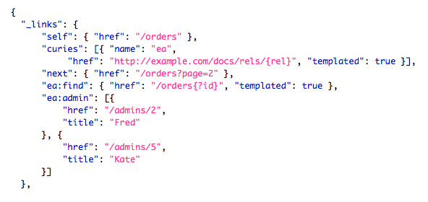
Spring Hateoas – JSON Example
Spring Hateaos provides an API for generating these links in MVC Controller responses

Slide 27
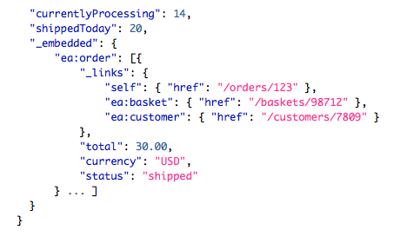
Spring Hateoas – JSON Example

Slide 28
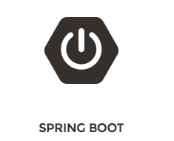
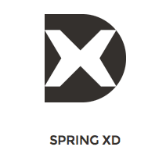
Spring IO Execution
Build on the foundations
Later: Part 2

Slide 29
Spring Boot
Write a deployable Spring application in just a few lines
Many defaults out of the box
Override any/all as needed
Still need to setup your build environment (ant, maven, gradle)
Can run as a Java application
Deploys to embedded container (Tomcat by default)
Or deploy as a war in usual way
Java Configuration or XML supported plus autowiring and component-scanning

Slide 30
Simplest Program (Standalone)
Just one class – an MVC Controller
This annotation tells Spring
Boot to use all its defaults
@Controller
@EnableAutoConfiguration
public class SampleController {
@RequestMapping(”/")
@ResponseBody
String home() {
return "<body><h1>Hello World!</h1><p>Instant web-app</p></body>";
}
public static void main(String[] args) throws Exception {
SpringApplication.run(SampleController.class, args);
}
}
Initial class to run
Run as Java application and got to http://localhost:8080/

Slide 31
Extend: Run as a WAR, Pull-in extra code
Extend SpringBootServletInitializer
Use component scanning or XML configuration to define Controllers, Services etc
@EnableAutoConfiguration
@ComponentScan({ "org.project.myapp" })
@ImportResource(value = "classpath:config/security.xml")
public class Main extends SpringBootServletInitializer {
@Override
protected Class<?>[] getConfigClasses() {
return new Class<?>[] { Main.class };
}
}
Tells Spring Boot to
run up as a war
Initial class to run (itself)

Slide 32
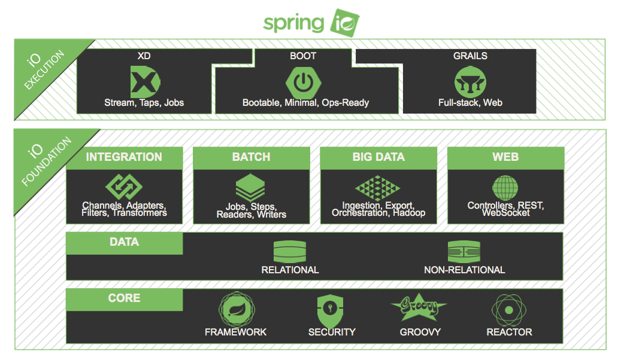
Spring IO Platform

Slide 33


Part 2: Spring XD / GemFire
Pas Apicella Senior Field Engineer, Pivotal
papicella@gopivotal.com
GitHub: papicella – these slides and demos

Slide 34
Let’s Get Pivotal
Pivotal Stack
Spring XD
GemFire

Slide 35
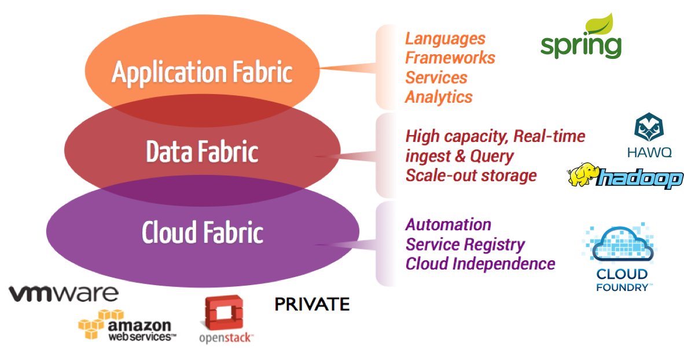

Pivotal Stack

Slide 36


What Do We Want From the Next Gen OLTP?
OLTP features (Query, DML, Transactions) PLUS
Very high scale (concurrency)
Low, predictable memory reqs
Very high volume
HDFS (Hadoop)
Global visibility to data
Extreme HA
Integrates with other DBs
Flexible schema (SQL, Objects, JSON)
Run-time elasticity (Cloud ready)
Supports Stream processing
Application Fabric
Languages
&
Frameworks
Services
Analytics
SQL, Objects, JSON
Real time Data Fabric
In-Memory Big Data
Transactions, Replication, WAN
HDFS – Scaleout storage
Data Fabric
Deep, Scalable SQL Analytics ….

Slide 37








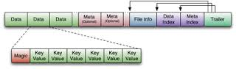
Enterprise Real-Time Data Service – Pivotal HD
Analytic Apps
Sensor Data / Feeds
Online Apps
Pivotal HD Enterprise
Map-Reduce
Model Refresh
GemFire XD
Model Refresh
HAWQ
Command Center
I/P & O/P
Formatter
PXF
Native Persistence
Re-evaluate Model
Re-evaluate Model
HDFS
Shared Data - HFiles
Notes:
High concurrent query caching via SQLFire/Gemfire
Seamless Real-Time Data Management on HDFS in progress
Extreme Volume : Addressing the Real- Time Scale Out Needs
Active-active WAN replication
Very low & predictable latencies at high & variable loads
10s of TBs in-memory
Multi-tiered caching
Efficient in-memory M-R
Real-time event processing and continuous querying
Native HDFS persistence – scale to 100s of TBs
ETL-less bi-directional integration with other Pivotal HD services
Managed as a service on the Pivotal HD platform

Slide 38
Let’s Get Pivotal
Pivotal Stack
Spring XD
Spring Data GemFire

Slide 39
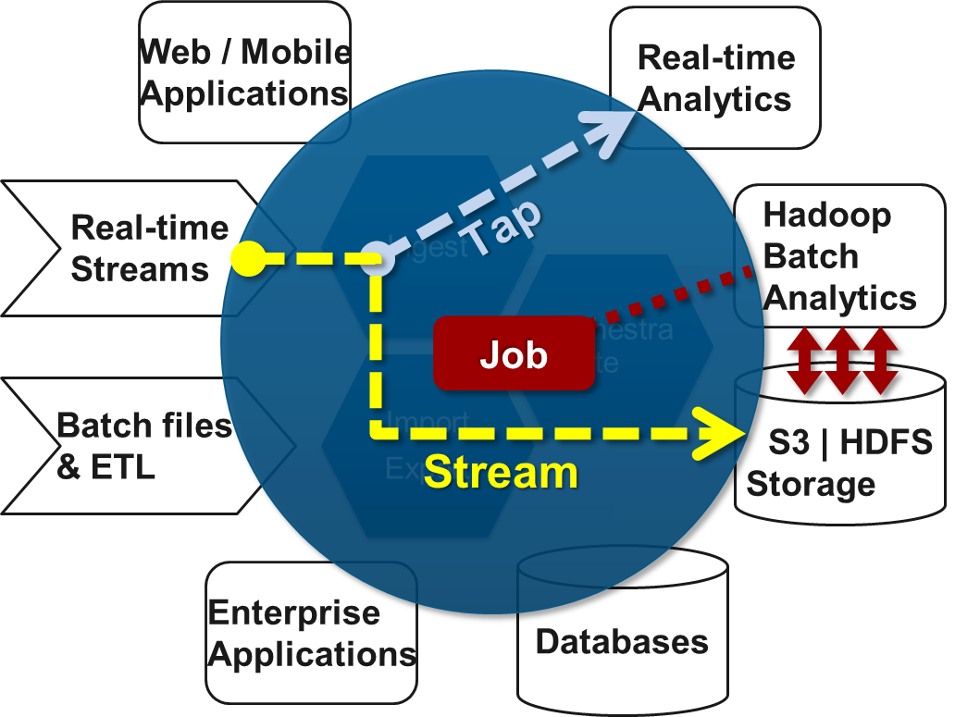
Spring XD - Tackling Big Data Complexity
Unified agile experience for
Data Ingestion
Real-time Analytics
Workflow Orchestration
Data Export
Built on existing assets
Spring Integration
Spring Batch
Spring Data (Redis, GemFire, Hadoop)
XD = 'eXtreme Data’
or 'x' as a variable (big, fast, diverse)

Slide 40
Spring XD – Features
Unified Platform
Developer Productivity
Modular Extensibility
Distributed Architecture
Portable Runtime
Hadoop Distribution Agnostic
Proven Foundation
Notes:
Unified platform across big data domains
Stream processing: ingestion & analytics
Batch processing workflow orchestration & export
Productivity
High level DSL for managing streams and jobs
Proven foundation
Built on existing assets: Spring Batch, Integration, Data
Extensible
DI, Test friendly…
Distributed
A | B | C - Pluggable transports: Rabbit, Redis, …
Portable Runtime
Standalone – Simplicity and testability
YARN –Fault Tolerance and Scalability
In-memory data grids – co-location of reference data.
PAAS
Hadoop Distribution Agnostic

Slide 41
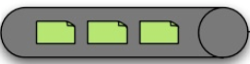



Spring XD
Files
Sensors
Mobile
Social
Spring XD Shell
Spring XD Runtime
Streams
Jobs
Taps
Ingest
Workflow
Export
Export
Redis
Compute
RDBMS
Gemfire
HDFS
NoSQL
Predictive modeling
R, SAS
Notes:
Now have a unified platform that handle the whole thing.
TODO – get rid of mobile?....
XD runtime address both stream and batch processing in a unfired manner.
XD runtime address both stream and batch processing in a unfired manner.

Slide 42
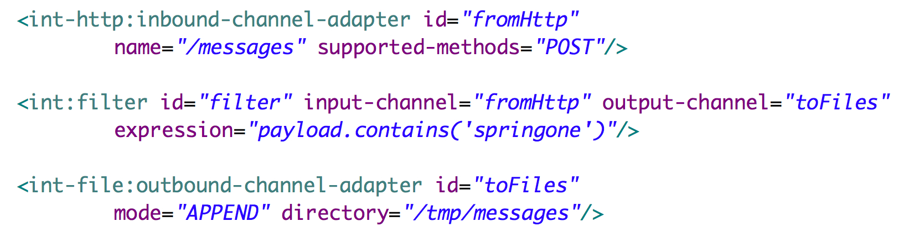
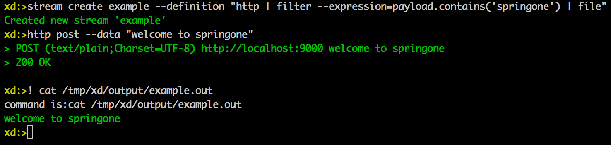
Stream Processing Model
http | filter | file
How can we make this easier?

Slide 43

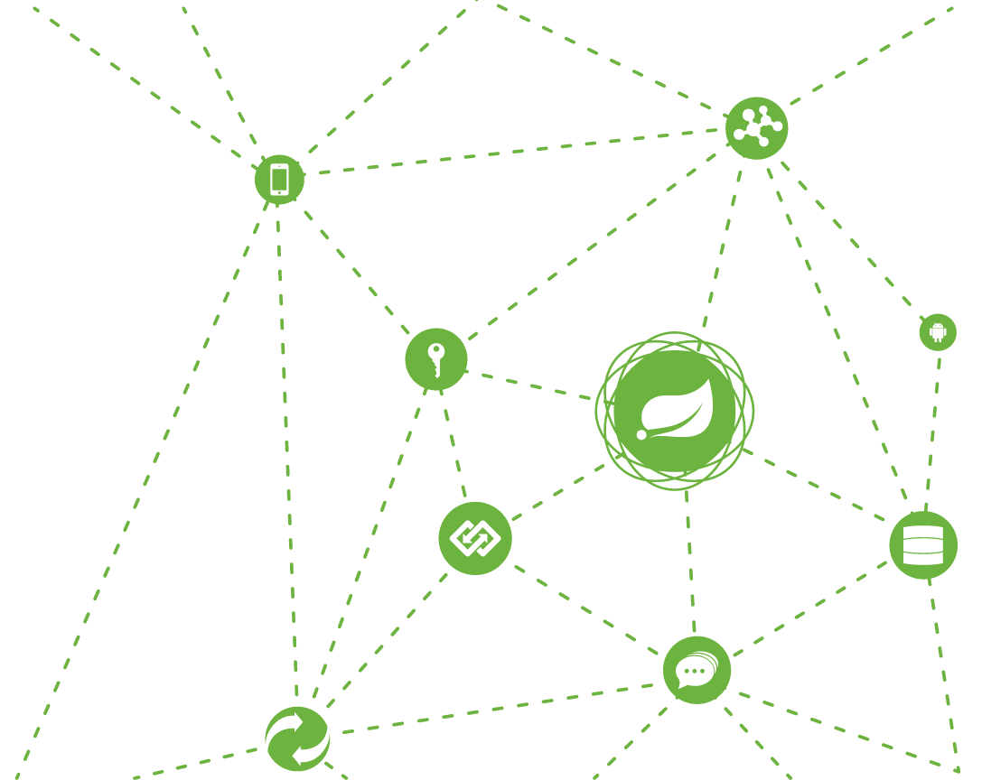

Spring XD Demo
Notes:
Download the distribution….
Basic demo with lay of the land
time | log
http | file
List streams
Tap to a counter, show increasing the counter.
http | file
List streams
Twitter | hdfs
Add tap with a counter

Slide 44
Let’s Get Pivotal
Pivotal Stack
Spring XD
GemFire

Slide 45







Pivotal GemFire
Primary Use Cases
Web Session Cache, L2 Cache
Shopping Cart state management
App Data Cache, In-memory DB
High performance OLTP
Grid Data Fabric
Shared data grid accessed by many clients executing app logic
… or where app logic is executed within the data fabric itself
Synchronise data across remote data centres in near real time
Extreme Data
Scalability & Elasticity
Application Data Lives Here
Application Data Sleeps Here
Mainframes
/ other
File Systems
Databases
Notes:
Use Cases 3 and 4 are where GemFire excels, and is where we start to get well beyond simple caching technologies. There are really only a couple of products that address this in an enterprise manner: GemFire and Oracle Coherence.
Use Case 3:
Customer is creating a true data grid: lots of clients, connecting to many nodes, some of which may cross WAN’s
The data is kept in sync across all nodes at all times and so is highly available. Data can be persisted using lazy writes in order to achieve database-like reliability
The data grid can be used to publish and subscribe messages across topologies – and so for many use cases acts as the message broker as well as the data store – eliminating the need for a messaging layer altogether
There are typically many clients: one of the scenarios we often see is where the clients are desktops, executing macros and pulling real time data from the data grid. This is in fact a significant mostly what the financial services customers are doing on Wall Street: pretty much every bank is using GemFire today (primarily for their trading apps)
The clients are pulling data from the grid and executing some kind of logic on the data – similar to a typical messaging use case with a message broker, except much faster because the data is always local to the app that needs it. In this way you get huge improvements in throughput
Scenario 4
The primary difference when compared to #4 is that the execution is actually being done IN THE DATA LAYER. Both GemFire and Coherence have the ability to execute code within the process – and so allowing for an even greater throughput when compared to scenario #3. In this case it somewhat blurs the line between the typical 3 tier architecture…and so is a pretty high-end use case. However that being said, it is in fact what high end fin services customers are doing with the product.
The end result is really about faster throughput. I would guess that this would be of interest to Reuters given what they do. I believe that they use Tibco for messaging (at one time they were an investor in Tibco if I recall correctly) and so they may have strong architectural opinions about how to achieve scale for messaging, but at the data layer they would need something like GemFire.

Slide 46
Gemfire Basic Concepts
Cache represents a member of a GemFire Distributed System (a node, a JVM)
Data is stored in one or more Regions
Effectively a distributed key/value store, implementing java.util.Map
Has own OQL syntax for queries
Person person = new Person(1, "Pas", "Apicella");
region.put(1,person);
person = region.get(1);
region.query( );
"SELECT * FROM /Person WHERE lastname = 'Apicella'"

Slide 47
Spring Data Gemfire Entity Mapping
Mapping simpler than JPA
Objects stored directly, no table mapping required
@Region
public @Data class Contact implements Serializable {
@Id
private Long productId;
private String firstname, lastname;
private Set<Phone> phones = new HashSet<Phone>();
private EmailAddress emailAddress;
private Map<String,String> attributes = ...;
}

Slide 48
Spring Data Gemfire Repositories
Based on repository infrastructure in Spring Data Commons
Define repository interface and namespace configuration
Just like JPA example earlier
public interface ContactRepository
extends CrudRepository<Contact, Long> {
List<Contact> findByFirstName(String firstName);
List<Contact> findBySurnameStartsWith(String surname);
}
<gfe:repositories base-package="com.acme.**.repository" />

Slide 49
Use GemFire’s OQL to Query
public interface ProductRepository
extends CrudRepository<Product, Long> {
@Query("SELECT * FROM /Product WHERE attributes[$1] = [$2]")
List<Product> findByAttributes(String key, String value);
}
JPA example used JPQL, Gemfire has its own OQL
public @Data class Product implements Serializable {
@Id
private Long productId;
private String name, description;
private BigDecimal price;
private Map<String,String> attributes = ...;
}

Slide 50
Gemfire Template class
Like JdbcTemplate, simpler for ad hoc queries
// Created for a specific GemFire Region
GemfireTemplate empTemplate =
new GemfireTemplate((Region) ctx.getBean("employees"));
// Shorter query code
SelectResults<?> results = empTemplate.query("deptno = 40");
Collection<Employee> emps = results.asList();
for (Employee e: emps) {
System.out.println(e.toString());
}

Slide 51

TRAINING
Core Spring Sydney: 03 Feb 2014
Spring Web Sydney: 03 Mar 2014
Register at vmware.com/education
Questions?
papicella@gopivotal.com
GitHub: papicella – these slides and demos
pchapman@gopivotal.com
GitHub: paulc4 – these slides and demos

Slide 52
Thank You

